Slide 1
Data Visualization Project Using Power BI
HOSPITALITY DOMAIN

Slide 2
Business Objective
AtliQ is a company that owns multiple hotel chains across various cities of India.
The Managing director / CEO of AtliQ wants to incorporate ‘Business and Data Intelligence’ to identify and track the source of revenue for AtliQ hotels.
Hence, it is decided to develop a KPI Dashboard for AtliQ, using May-22 to July-22 data, which can help track its revenue sources and other relevant KPIs across various dimensions.
It’ll help the management take strategic business decisions based on the insights generated from the dashboard.

Slide 3
Problem Statement
Identify the data sources pertaining to revenue management
Clean and model the data as per requirement for analysis
Create a revenue dashboard that measures important KPIs
Relevant filters need to provided to slice and dice the data
The dashboard should depict both high level and granular insights

Slide 4
Solution Approach
There are 5 tables provided for tracking revenue, 3 dimension tables (date, hotel, room) and 2 fact tables (bookings, aggregated bookings)
Power BI was the tool used for creating the visualization/dashboard
The data was imported, analysed and transformed as per necessity within Power Query
The relationships between the tables were created within Power Pivot

Slide 5
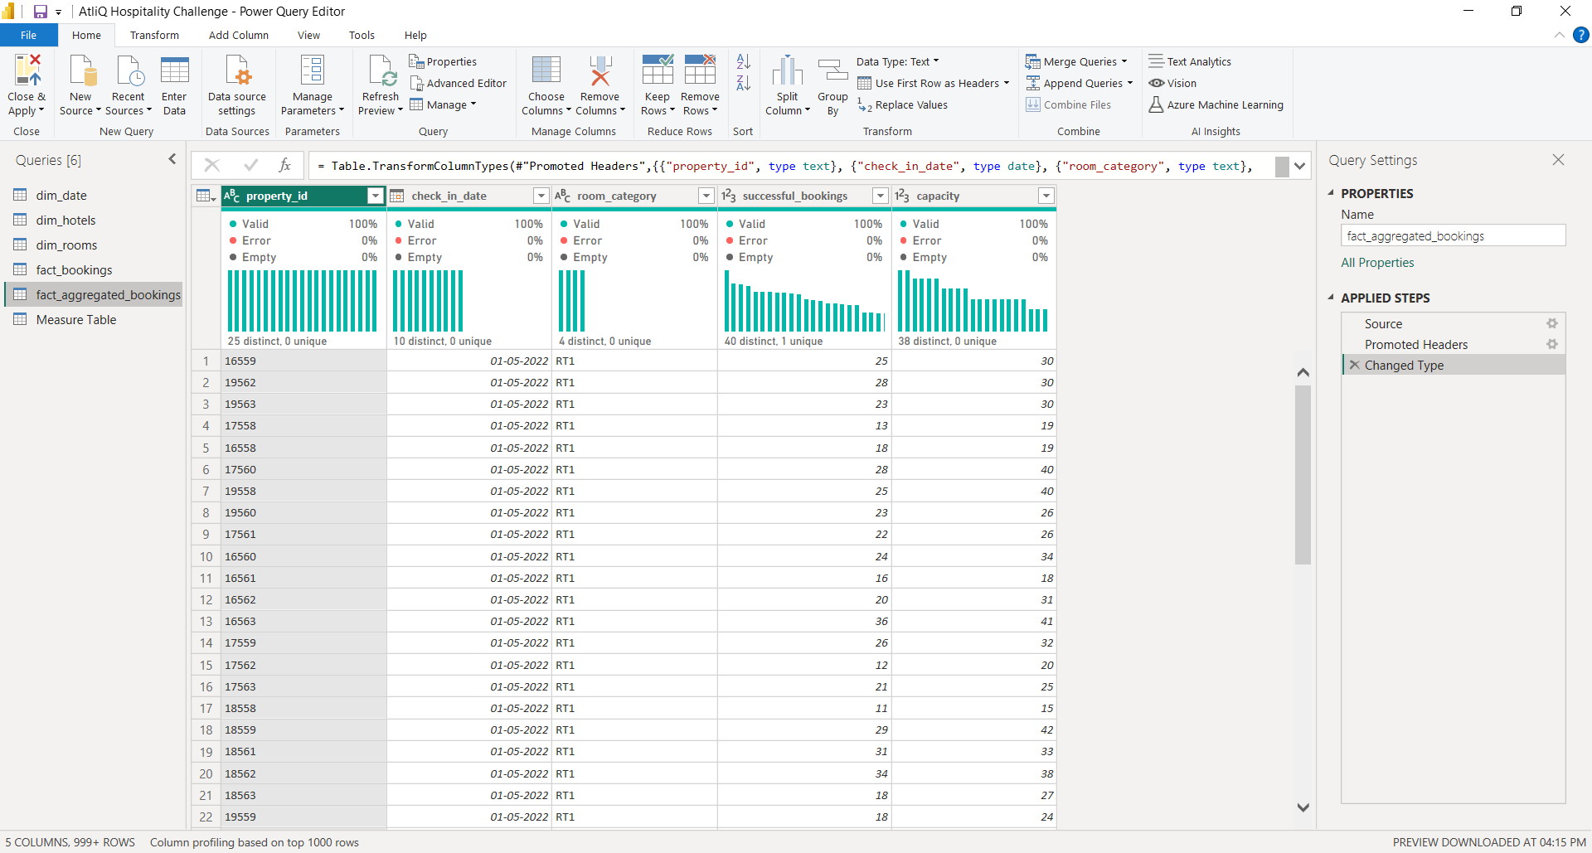
DATA CLEANIN/TRANSFORMATION IN PQ EDITOR

Slide 6
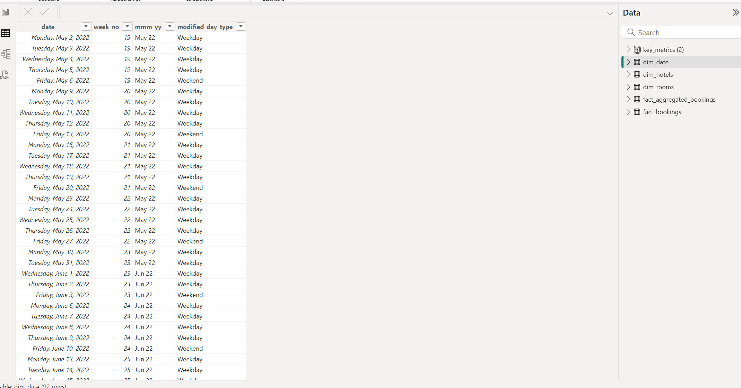
Power BI Table View

Slide 7
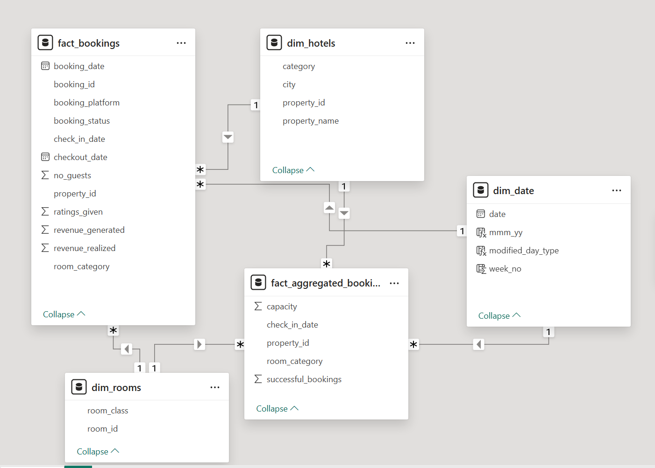
MODEL VIEW IN POWER BI

Slide 8
DAX FUNCTIONS
Using the DAX functions, we have created calculated columns.
Ex:
week_no
day_type
Also, we have created the key metrices.
Ex:
Revenue
RevPAR – Revenue Per Available Rooms
ADR – Average Daily Rate
DSNR – Daily Sellable Room Nights

Slide 9
SOLUTION APPROACH
Calculated Columns:
Week_no = WEEKNUM(dim_date[date])
day_type = Var wkd = WEEKDAY(dim_date[date],1) return IF( wkd>5,"Weekend","Weekday")

Slide 10
SOLUTION APPROACH
Measures:
Revenue = SUM(fact_bookings[revenue_realized])
RevPAR = DIVIDE([Revenue],[Total Capacity])
ADR = DIVIDE( [Revenue], [Total Bookings],0)
Occupancy % = DIVIDE([Total Succesful Bookings],[Total Capacity],0)
DSRN = DIVIDE([Total Capacity], [No of days])
Realisation % = 1- ([Cancellation %]+[No Show rate %])

Slide 11
Continues…..
Revenue WoW change % =
Var selv = IF(HASONEFILTER(dim_date[wn]),SELECTEDVALUE(dim_date[wn]),MAX(dim_date[wn])) var revcw = CALCULATE([Revenue],dim_date[wn]= selv) var revpw = CALCULATE([Revenue],FILTER(ALL(dim_date),dim_date[wn]= selv-1)) return
DIVIDE(revcw,revpw,0)-1
Like the above measure, we have created for DSRN WoW change % , Revpar WoW change % ,ADR WoW change %, Occupancy WoW change % , Revenue WoW change % .

Slide 12
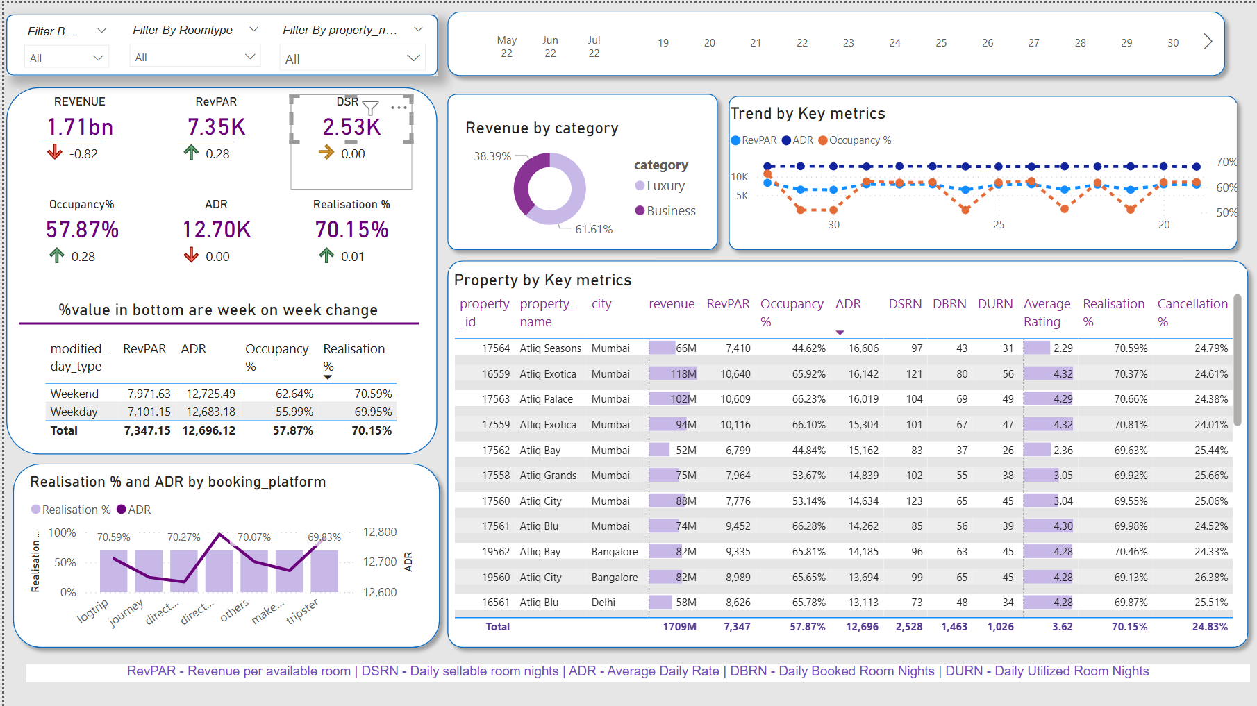
REPORT VIEW

Slide 13
Features of Dashboard
1.Revenue Performance
Total Revenue: ₹1.71 billion — slight week-on-week dip (↓0.82%), indicating a need to assess demand or pricing changes.
Top Revenue Generators:
Atiiq Exotica Mumbai (₹118M)
Atiiq Palace Mumbai (₹102M)
Outcome: Mumbai properties are leading in revenue. Strategic focus should remain on optimizing these locations.
2. Occupancy & Room Utilization
Overall Occupancy: 57.87% — modest increase (↑0.28%) but still below optimal (typically ~70% is considered healthy).
Room Sellability (DSR): Steady at 2,530 rooms, suggesting stable capacity.
Utilization (DURN): Only 1,026 rooms, ~40% of total sellable rooms.
Outcome: There's under-utilization of available inventory — indicates potential to drive more bookings via marketing or better yield management.

Slide 14
Continues…
3.RevPAR & ADR Insights
RevPAR: ₹7.35K (↑0.28%)
ADR: ₹12.70K (Flat week-on-week)
Outcome: Revenue per room is improving despite flat ADR — this is driven by better occupancy. Focus on increasing stay volumes can further boost revenue.
4.Weekday vs Weekend Performance
Weekends outperform weekdays:
Weekend Occupancy: 62.64%
Weekday Occupancy: 55.99%
Outcome: There's stronger demand on weekends. Consider special weekday offers or business travel campaigns to boost midweek performance.

Slide 15
Continues…
5. Channel Performance
Top Performing Booking Platforms:
Tripster shows high Realisation % (~69.83%) and strong ADR
Lowest Realisation %: direct offline
Outcome: OTA (online travel agency) platforms are yielding better revenue than direct bookings. Evaluate direct channel pricing/UX to increase competitiveness.
6. Category Split
Business: 61.61%
Luxury: 38.39%
Outcome: Majority revenue comes from business travel segment. Ensure offerings, services, and marketing are aligned with business travelers’ needs.

Slide 16
Continues…
7. Cancellations & Ratings
Average Cancellation Rate: 24.83% — relatively high
Average Rating: 3.62/5 — scope for improvement
Outcome: High cancellations and moderate guest satisfaction suggest areas for process or service improvement (e.g., flexible booking, better customer experience).

Slide 17
Conclusion
A revenue dashboard was built for AtliQ hotels depicting its various KPIs visually.
Relevant filters along with tooltips and interactions was provided in the dashboard.
This dashboard can be used for both high-level and in-depth analysis of KPIs across various dimensions.

Slide 18


